Slide 1
Syllabus: Unit-II
Creating and Starting the Venture:
Sources of new Ideas,
Methods of generating ideas.
The Business Plan Nature and scope of Business plan, Writing Business Plan,
Evaluating Business plans,
Using and implementing business plans.
Marketing plan, financial plan and the organizational plan, Launching formalities.

Slide 2
Sources of New Ideas
Consumers
  Informally monitor potential ideas and needs.
  Formally arrange for consumers to express their opinions.
Existing Products and Services
  Analysis uncovers ways to improve offerings that may result in a new product or service.
Distribution Channels
  Channel members can help suggest and market new products.
Government
  Files of the Patent Office can suggest new product possibilities.
  New product ideas can come in response to government regulations.
Research and Development
  A formal endeavor connected with one’s current employment.
  An informal lab in a basement or garage.

Slide 3
Methods of Generating New Ideas
Focus Groups
  A moderator leads a group of 8 to 14 participants through an open, in-depth discussion in a directive or nondirective manner.
  An excellent method for generating and screening ideas and concepts.
Brainstorming
  Allows people to be stimulated to greater creativity.
  Good ideas emerge when the brainstorming effort focuses on a specific product or market area.
    Rules of brainstorming:
    No criticism.
    Freewheeling is encouraged.
    Quantity of ideas is desired.
    Combinations and improvements of ideas are encouraged.

Slide 4






Focus Groups

Slide 5
Methods of Generating New Ideas (cont.)
Brainwriting
  A form of written brainstorming.
  Participants write their ideas on special forms or cards that circulate within the group.
Problem Inventory Analysis
  Consumers are provided with a list of problems and are asked to identify products that have those problems.
  Results must be carefully evaluated as they may not actually reflect a new business opportunity.
Brainstorming
  Session starts with a problem statement.
  No group member should be an expert in the field of the problem.
  All ideas must be recorded.

Slide 6
Creative Problem Solving
Reverse Brainstorming
  A group method that focuses on the negative aspects of a product, service, or idea as well as ways to overcome these problems.
  Care must be taken to maintain group morale.
Checklist Method
  Developing a new idea through a list of related issues.
Free Association
  Developing a new idea through a chain of word associations.
Forced Relationships
  Developing a new idea by looking at product combinations.
  A five step process which focuses on generating ideas from relationship patterns between elements of a problem.
Collective Notebook Method
  Developing a new idea by group members regularly recording ideas.

Slide 7
Creative Problem Solving (cont.)
Checklist Method
  Developing a new idea through a list of related issues.
Free Association
  Developing a new idea through a chain of word associations.
Forced Relationships
  Developing a new idea by looking at product combinations.
  A five step process which focuses on generating ideas from relationship patterns between elements of a problem.
Collective Notebook Method
  Developing a new idea by group members regularly recording ideas.
Attribute Listing
  Developing a new idea by looking at the positives and negatives.
Big-Dream Approach
  Developing a new idea by thinking without constraints.
Parameter Analysis
  Developing a new idea by focusing on parameter identification and creative synthesis.

Slide 8
The Business Plan : Creating and Starting the Venture
Planning is a process than never ends for a business.
It is extremely important in the early stages of any new venture when the entrepreneur will need to prepare a preliminary business plan.
As the venture grow up to mature business, planning will continue ...
Plan may be short term or long term, strategic or operational.

Slide 9
What is Business Plan?
The business plan is a written document prepared by the entrepreneur that describes all the relevant internal and external elements and strategies for starting a new venture.
It is a integration of functional plans such as
marketing,
finance,
manufacturing, sales and
human resources.

Slide 10
Scope and Nature of the Business plan
The business plan may be read by employees,
employees, investors, venture capitalists
bankers, suppliers
customers, advisors, and consultants
by the entrepreneur himself
There are three perspectives should be considered in preparing the plan :
Perspective of the entrepreneur
Marketing perspective
Investor’s perspective

Slide 11
Purpose of a Business Plan
Alignment of team(s)
Operating plan
Communication across company, division, department, business partners
Investment capital
Expansion capital (banks, leases)
Merger/acquisition process

Slide 12
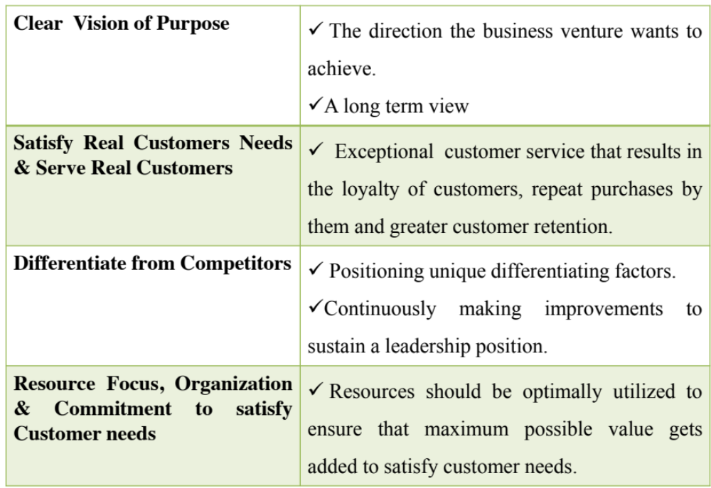
BUSINESS PLAN Drivers

Slide 13
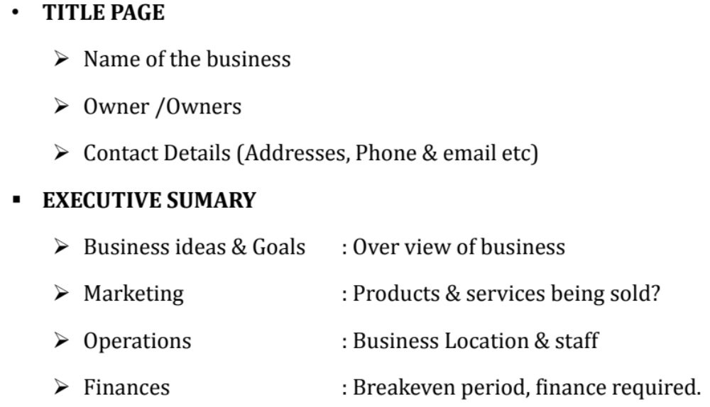
Format of Business Plan

Slide 14
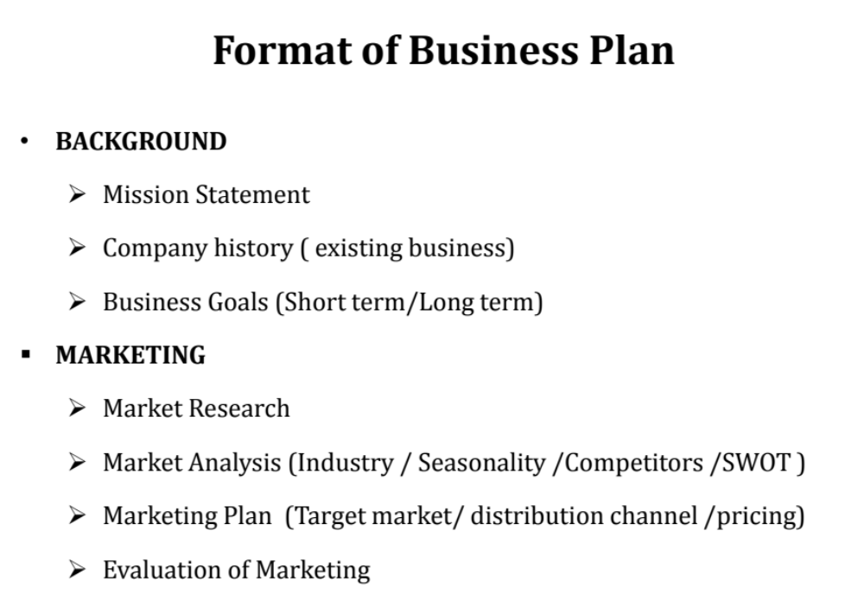

Slide 15
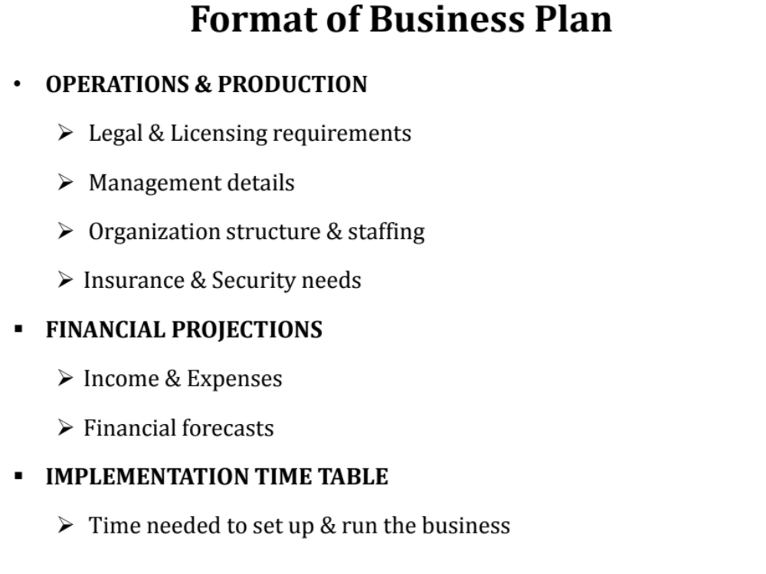

Slide 16
Writing the Business Plan
A business plan should be comprehensive enough to give any potential investor a complete picture and understanding of the new venture.
It should help the entrepreneur clarify his or her thinking about the business.
Introductory Page
  Name and address of the company.
  Name of the entrepreneur(s), telephone number, fax number, e-mail address, and Web site address.
  Description of the company and nature of the business.
  Statement of financing needed.
  Statement of confidentiality of report.
Executive Summary
  About two to three pages in length summarizing the complete business plan.
Environmental and Industry Analysis
  The environmental analysis assesses external uncontrollable variables that may impact the business plan.
    Examples: Economy, culture, technology, legal concerns, etc.
  The industry analysis involves reviewing industry trends and competitive strategies.
    Examples: Industry demand, competition, etc.

Slide 17

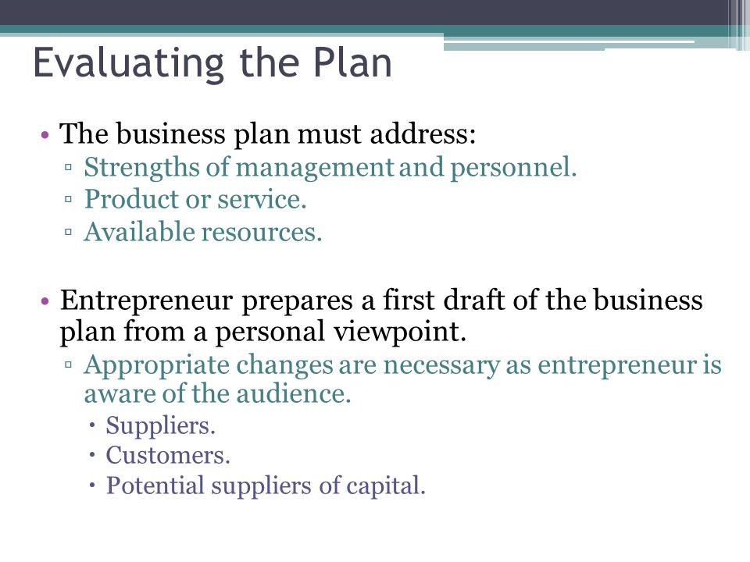
Evaluation of business plan

Slide 18
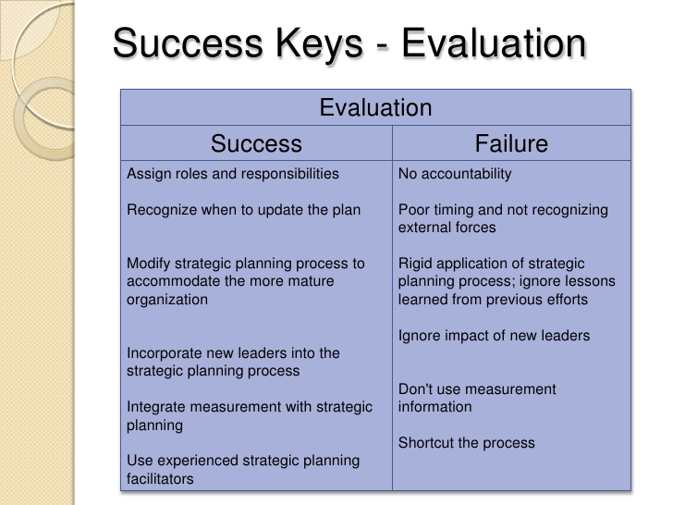
Success Keys

Slide 19

Evaluation of business plan

Slide 20
The following areas are of interest to lenders and investors:
The purpose of the loan (expansion or start-up business)
Sources and uses of the funds
Management of the business
Industry information
Financial analysis
Collateral (secured)
Personal debt/credit history of borrower

Slide 21
Technical Business Plans may be evaluated on the following:
Viability
Management background
Market advantage
Technology
This evaluation guide scores business plan elements on a scale from 1 to 10, with 10 being the best possible rating. Scores are subjective. The reader determines a value based on his or her perception of the quality and content of the business plan

Slide 22
Grading the Business Plan
There are six questions each worth 10 points.
50 - 60 High potential for success
40 - 50 Needs work, but loan is probable
30 - 40 Review deficiencies, workable
Under 30 Keep your day job

Slide 23
Using and Implementing the Business Plan
The business plan is designed to guide the entrepreneur through the first year of operations.
The strategy should contain control points to ascertain progress and to initiate contingency plans if necessary.
Without good planning employees will not understand the company’s goals.
Businesses fail due to entrepreneur’s inability to plan effectively.
Measuring Plan Progress
  Business plan projections are made on a 12-month schedule but the entrepreneur should frequently check on:
    Profit and loss statement.
    Cash flow projections.
    Inventory control.
    Production control.
    Quality control.
    Sales control.
    Disbursements.
    Web site control.

Slide 24
Using and Implementing the Business Plan (cont.)
Updating the Plan
  Entrepreneurs must be sensitive to changes in the company, industry, and market.
  Determine what revisions are needed if changes are likely to affect the business plan.
  This helps entrepreneurs to:
    Maintain reasonable targets and goals.
    Keep the new venture on a course to high probability of success.

Slide 25
USING AND IMPLEMENTING THE BUSINESS PLAN
Inventory control. By controlling inventory, the firm can ensure maximum service to the customer. The faster the firm gets back its investment in raw materials and finished goods, the faster that capital can be reinvested to meet additional customer needs.
Production control. Compare the cost figures estimated in the business plan with day- to-day operation costs. This will help control machine time, worker hours, process time, delay time, and downtime cost.
Quality control. This will depend on the type of production system but is designed to make sure that the product performs satisfactorily.
Sales control. Information on units, dollars, specific products sold, price of sales, meeting of delivery dates, and credit terms is useful to get a good perspective of the sales of the new venture.
Disbursements. The new venture should also control the amount of money paid out. All bills should be reviewed to determine how much is being disbursed and for what purpose.
Web site control. With more and more sales being supported or garnered from a company’s Web site, it is very important to continually evaluate the Web site to ascertain its effectiveness in meeting the goals and objectives of the plan.

Slide 26
Why Some Business Plans Fail
Goals are unreasonable.
Objectives are not measurable.
Entrepreneur has not made a total commitment to the business or to the family.
Lack of experience in the planned business.
No sense of potential threats or weaknesses to the business.
No customer need was established for the proposed product or service.

Slide 27
MARKETPLAN
A marketing plan may be part of an overall business plan. Solid marketing strategy is the foundation of a well-written marketing plan. While a marketing plan contains a list of actions, without a sound strategic foundation, it is of little use to a business.

Slide 28
MARKETING RESEARCH FOR THE NEW VENTURE
Step One: Defining the Purpose or Objectives
How much would potential customers be willing to pay for the product or service?
Where would potential customers prefer to purchase the product or service?
Where would the customer expect to hear about or learn about such a product or service?
Step Two: Gathering Data from Secondary Sources (trade magazines, newspaper articles, libraries, government agencies, and the Internet)
Step Three: Gathering Information from Primary Sources (observation, networking, interviewing, focus groups, or experimentation—and usually a data collection instrument, such as a questionnaire.)
Step Four: Analysing and Interpreting the Results

Slide 29
Outline for a Marketing Plan
Situation analysis
Background of venture
Strengths and weaknesses of venture
Market opportunities and threats
Competitor analysis
Marketing objectives and goals
Marketing strategy and action programs
Budgets
Controls

Slide 30
CHARACTERISTICS OF A MARKETING PLAN
It should provide a strategy for accomplishing the company mission or goal.
It should be based on facts and valid assumptions. It must provide for the use of existing resources. Allocation of all equipment, financial resources, and human resources must be described.
An appropriate organization must be described to implement the marketing plan.
It should provide for continuity so that each annual marketing plan can build on it, successfully meeting longer-term goals and objectives.
It should be simple and short. A voluminous plan will be placed in a desk drawer and likely never used. However, the plan should not be so short that details on how to accomplish a goal are excluded.
The success of the plan may depend on its flexibility. Changes, if necessary, should be incorporated by including what-if scenarios and appropriate responding strategies.
It should specify performance criteria that will be monitored and controlled.

Slide 31
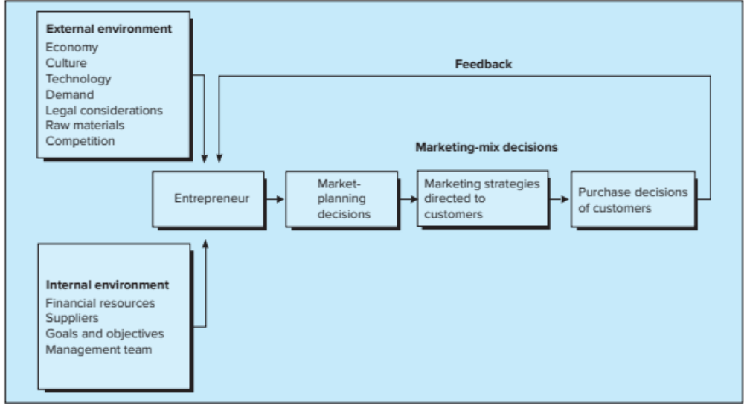
The Marketing System

Slide 32
Financial Plan
Each of the planning tools is designed to provide the entrepreneur with a clear picture of where funds come from, how they are disbursed, the amount of cash available, and the general financial well-being of the new venture.
The pro forma income statement provides a sales estimate in the first year (monthly basis) and projects operating expenses each month. These estimates are determined from the appropriate budgets, which are based on marketing plan projections and objectives.
Cash flow is not the same as profit. It reflects the difference between cash actually received and cash disbursements. Some cash disbursements are not operating expenses (e.g., repayment of loan principal); likewise, some operating expenses are not a cash disbursement (e.g., depreciation expense). Many new ventures have failed because of a lack of cash, even when the venture is profitable.

Slide 33
Financial Plan …
The pro forma balance sheet reflects the condition of the business at the end of a particular period. It summarizes the assets, liabilities, and net worth of the firm.
The break-even point can be determined from projected income. This measures the point where total revenue equals total cost.
The pro forma sources and applications of funds statement helps the entrepreneur understand how the net income for the year was disposed of and the effect of the movement of cash through the business. It emphasizes the interrelationship of assets, liabilities, and stockholders’ equity to working capital.
Software packages to assist the entrepreneur in accounting, payroll, inventory, billing, and so on are readily available. There are now many options for the entrepreneur including Web-based accounting services that can range from no cost to a nominal monthly fee depending on the financial need of the company.

Slide 34
Importance of Financial Planning
01.Adequate funds have to be ensured.
02. Financial Planning helps -balance between outflow and inflow of funds so that stability is maintained.
03. Financial Planning ensures that the suppliers of funds are easily investing in companies.
04. Financial Planning helps in making growth and expansion, which helps in long-run survival of the company.
04. Financial Planning reduces uncertainties with regards to changing market trends which can be faced easily through enough funds.
05. Financial Planning helps in reducing the uncertainties. This helps in ensuring stability and profitability in concern.

Slide 35
Organisational Plan
Investors demand that the management team not operate the business as a part- time venture.
It is assumed that the management team is prepared to operate the business full time and at a modest salary.
An attempt to draw a large salary out of the new venture may be perceived as a lack of commitment to the business.
Three basic legal forms of business:
Proprietorship - Single owner, unlimited liability, controls all decisions, and receives all profits.
Partnership - Two or more individuals having unlimited liability who have pooled resources to own a business.
Corporation - Most common form of corporation; regulated by statute (a written law passed by a legislative body); treated as a separate legal entity for liability and tax purposes.

Slide 36
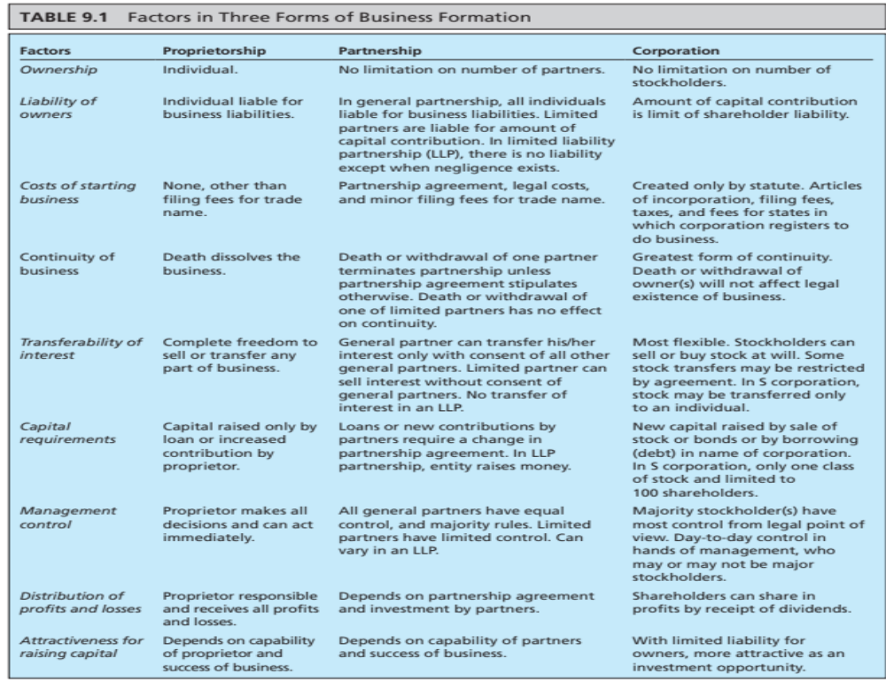

Slide 37
Designing the Organization
Organization structure: defining members jobs and the communication and relationship these jobs have with each other. These relationships are depicted in the organisation chart.
Planning, measurement and evaluation schemes: All organisation activities should reflect the goals and objectives that underlie the venture’s existence. The entrepreneur must spell out how these goals will be achieved (plan), how they will be measured and how they will be evaluated.
Rewards: members of the organisation will require rewards in the form of promotions, bonuses, praise and so on. The entrepreneur or other key managers will need to be responsible for these rewards.
Selection criteria: The entrepreneur will need to determine a set of guidelines for selecting individuals for each position.
Training: trainings, on or off the job must be specified. The training may be in the form of formal education or learning skills.

Slide 38
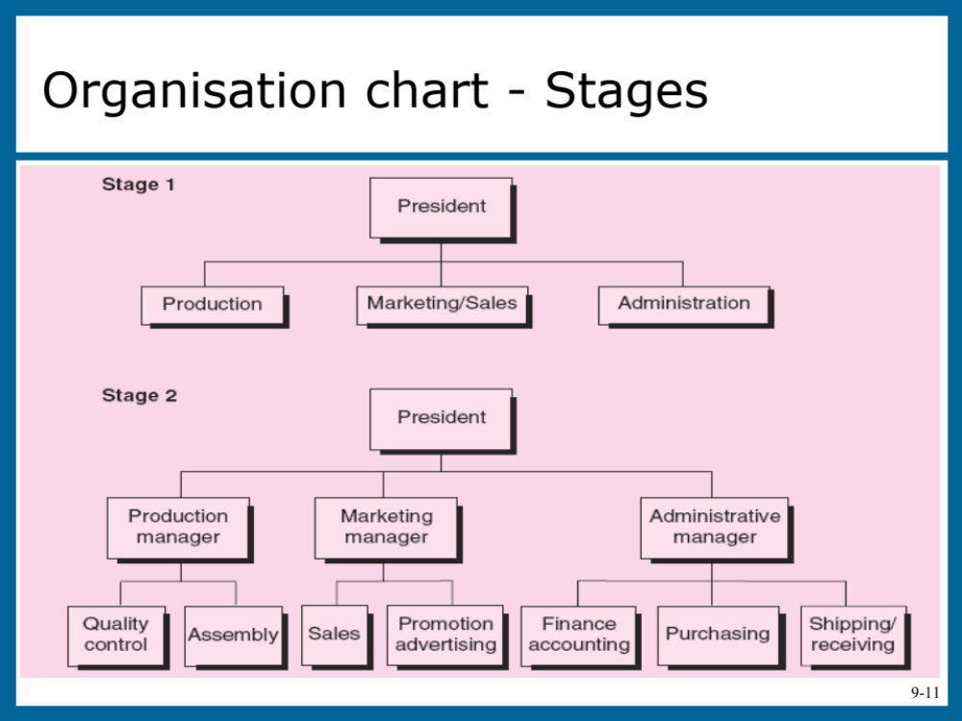

Slide 39
Building the successful organisation
Once the legal form of organisation is determined, and the roles necessary to perform all the important functions of the organisation are identified, the entrepreneur will need to do job analysis in detail.
The job analysis serve as a guide in determining job description, hiring procedures, training, performance appraisals, and compensation programs. A management team must be able to accomplish three functions:
  Execute the business plan.
  Identify fundamental changes in the business as they occur .
  Make adjustments to the plan as per changes in the business environment so that to maintain profitability.
Important factors in establishing an effective management team:
  Desired organisational culture (behaviour of humans within an organization and the meaning that people attach to those behaviours) must match business strategy outlined in the business plan.
  Employees must be motivated and rewarded for good work.
  Entrepreneur should be flexible to try different /new things.
  Spend extra time in the hiring process.
  Core values and appropriate tools must be provided for employees to effectively complete their jobs.

Slide 40
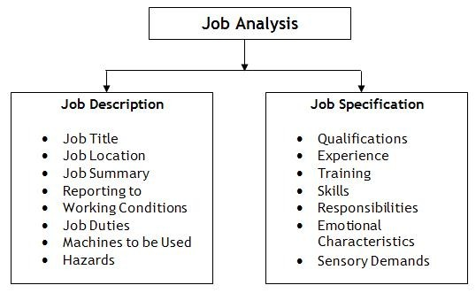
Building the successful organisation (cont.)
Job descriptions and specification
Job description specify details of work to be performed by an employee.
  A job description communicates to candidates regarding job that what will be expected of them to do once one will be employed. It should be written clear, direct and in simple language.
  Job specification enlists the details of knowledge and competencies (skills) needed to perform a specific job within an organisation.

Slide 41
Launching formalities
1. Go beyond the business plan
The Apprentice Model: Gaining direct industry experience, as the founders of Tender Greens did.
The Hired-Gun Approach: Partnering with experts who have in-depth knowledge and experience.
The Ultra-Lean School of Hard Knocks Tactic: Figuring out a way to rapidly test and refine your model at a very reasonable cost.
2. Test your idea.
3. Know the market.
4. Understand your future customer.
5. Establish cash resources.
6. Choose the right business structure.

Slide 42
Unit-2 Questions Short questions
What are the sources of new ideas?
How new ideas are generated?
What are the rules of brainstorming?
What are the problems encountered in inventory analysis?
How brainstorming is different from reverse brainstorming?
What is business plan?
What are the perspectives considered in business plan preparation?
What are the purposes of business plan?
What are factors considered as business plan drivers?
List the success keys for evaluation of business plan?
What are the areas lenders and investors interested in business plan evaluation?
How could be technical business plans evaluated?
How to measure the business plan progress?
Why few business plans fail?
What are the primary and secondary sources of marketing information?
What are the external factors affecting the marketing system?
What are the internal factors affecting the marketing system?
What are the basic forms of organizational plan?
What are factors used to establish management team effectively?
How to differentiate job description and job specification?

Slide 43
Descriptive Questions
Discuss various sources of ideas for new ventures.
Discuss methods available for generating new venture ideas.
Explain creative problem-solving process.
Explain business plan drivers.
Discuss the process of writing business plan.
Discuss about using and implementation of business plan.
Explain the various characteristics of a marketing plan.
Explain financial planning process and its importance.
Explain the designing process of the organisation plan.
Explain the process of building the successful organisation.

